Slide 1
Natural Language Processing (NLP)

Slide 2
Challenges of NLP
Even state-of-the-art NLP models are not perfect, just as human speech is prone to error.
As with any AI technology, NLP comes with potential pitfalls.
Human language is filled with ambiguities that make it difficult for programmers to write software that accurately determines the intended meaning of text or voice data.
Human language might take years for humans to learn and many never stop learning.
But then programmers must teach natural language-powered applications to recognize and understand irregularities so their applications can be accurate and useful.

Slide 3
Biased training
As with any AI function, biased data used in training will skew the answers.
The more diverse the users of an NLP function, the more significant this risk becomes, such as in government services, healthcare and HR interactions.
Training datasets scraped from the web, for example, are prone to bias.

Slide 4
Misinterpretation
As in programming, there is a risk of garbage in, garbage out (GIGO).
Speech recognition, also known as speech-to-text, is the task of reliably converting voice data into text data.
But NLP solutions can become confused if spoken input is in an obscure dialect, mumbled, homonyms, incorrect grammar, idioms, fragments, mispronunciations, contractions or recorded with too much background noise.

Slide 5
New vocabulary
New words are continually being invented or imported.
The conventions of grammar can evolve or be intentionally broken.
In these cases, NLP can either make a best guess or admit it’s unsure and either way, this creates a complication.

Slide 6
Tone of voice
When people speak, their verbal delivery or even body language can give an entirely different meaning than the words alone.
Exaggeration for effect, stressing words for importance or sarcasm can be confused by NLP, making the semantic analysis more difficult and less reliable.

Slide 7
Reading Assignment
History of NLP

Slide 8
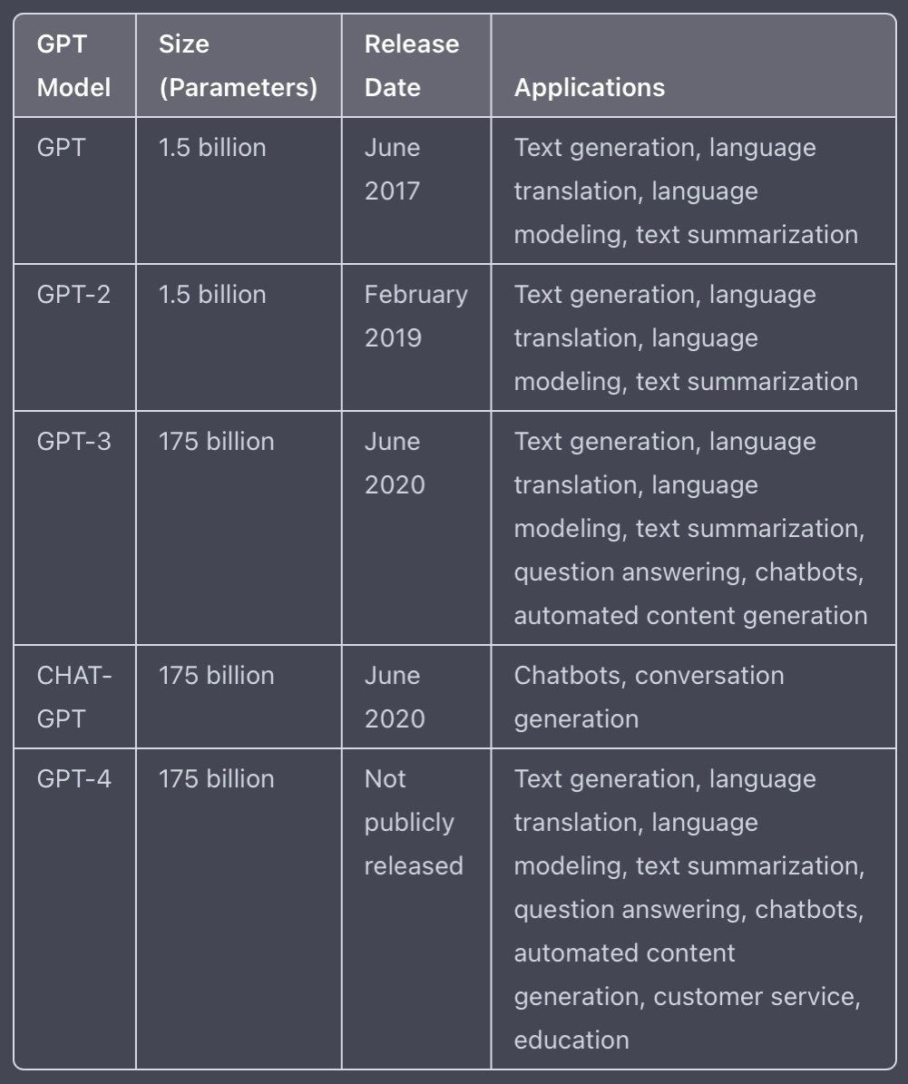
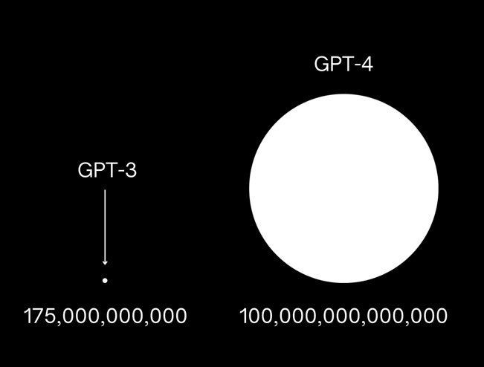
We are Waiting for GPT-4
We are Waiting for GPT-5
November 2022

Slide 9
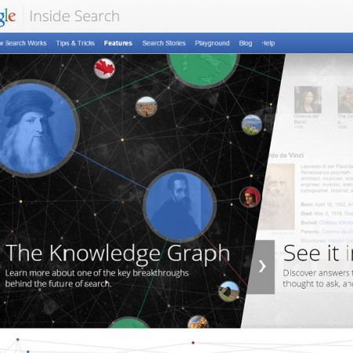
Knowledge & Information Extraction
Knowledge graphs (KGs) organize data from multiple sources, capture information about entities of interest in a given domain or task (like people, places or events)
The Google Knowledge Graph is an enormous database of information that enables Google to provide immediate, factual answers to your questions

Slide 10
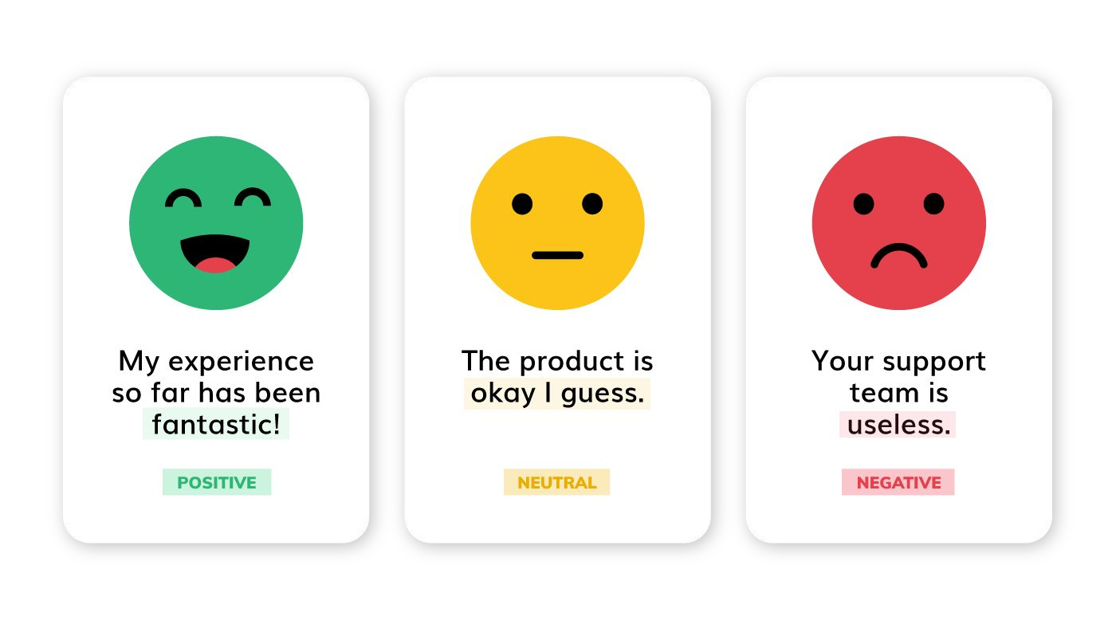
Sentiment Analysis
Determine whether the meaning behind data is positive, negative, or neutral

Slide 11
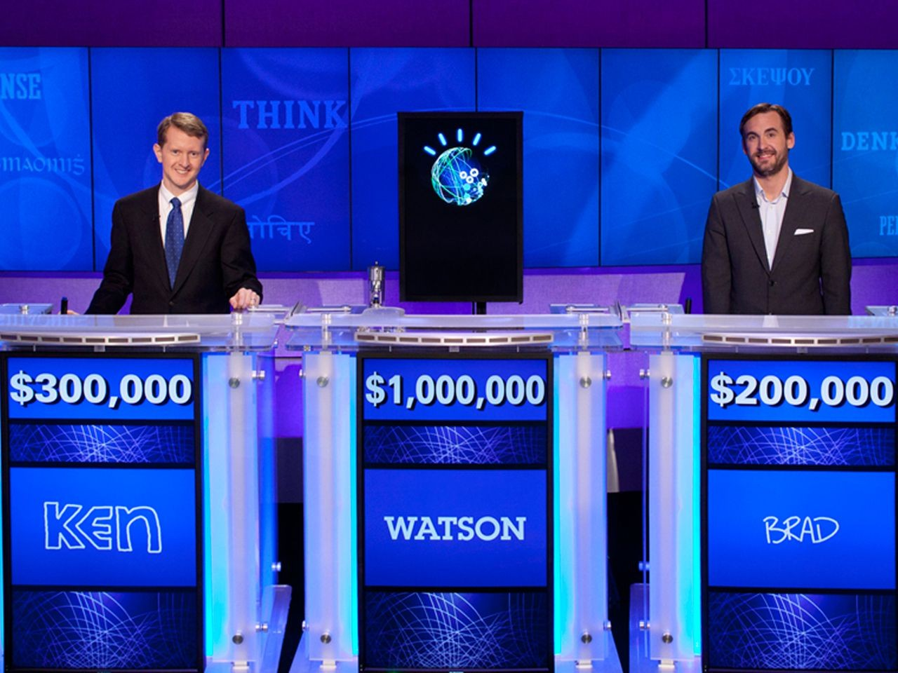
Question Answering
IBM-Watson Defeats Humans in "Jeopardy!"

Slide 12
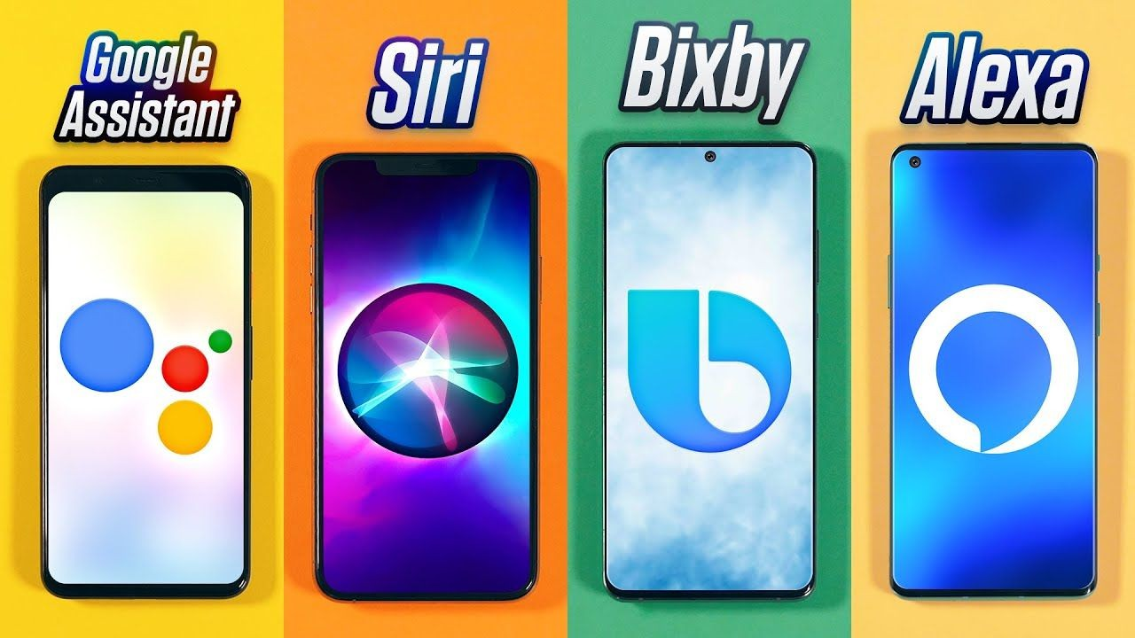
Spoken Dialog Systems

Slide 13

Summary
Today we learned about:

